Slide 1

HCHD Board Report
Presented by: Senior Leadership Team
March 24, 2022

Slide 2
Marketing Update
Trapper Collova

Slide 3


WHERE WE ADVERTISE
ROUTINELY

Slide 4







WHERE WE REGULARLY ADVERTISE
LOCAL PUBLICATIONS
CHURCH BULLETINS
SCHOOL PUBLICATIONS
NEWCOMER GUIDES
EVENT PROGRAMS

Slide 5
AVERAGE MONTHLY SPRHC ADVERTISING

Slide 6
BOD MARKETING CALENDAR
Subject to unplanned additions (employment, events, activities)
Calendar includes primary advertising mediums/outlets – collateral, signage, projects and other marketing initiatives not included

Slide 7
BOD MARKETING CALENDAR

Slide 8


CDHS Report
Prepared for the HCH District Board
03/24/2022

Slide 9
VCLC Updates
Division is recruiting for Director of Clinical Operations, SME in skilled nursing
VCLCs have cleared outbreaks
VCLCs focused on census development
NASVH Winter Conference April 11-14, 2022
  Primary focus of conference is on the “modernization” of the VA

Slide 10
VCLC Liaison Recruitment Update
VCLC Liaison (formerly Project Officer) is Mahleenee Wright
start date May 2, 2022
Air Force Veteran
Experience with veterans healthcare and the VA

Slide 11

Elizabeth Mullins
VCLC Division Director
elizabeth.mullins@state.co.us

Slide 12
CEO Report
Kay Whitley

Slide 13
Updates
Staffing Challenges:
  Currently utilizing agency nurses/Aides (Acute and LTC)
  We are working with Employers Council to provide an updated market comparison for all staff. Phase 1 underway
  Anesthesia/Pain Management
    Dr. Keith Nichols (prn agreement signed 3/14 – scheduled to start in May)
Internal Medicine : Dr. Stark
Rural Conferences:
  CRHC Annual Conference October 19th-21st in Colorado Springs
  CHA Annual Conference Sept 28th-October 1st in Colorado Springs

Slide 14
Projects
Current projects underway:
  Retail Pharmacy
  VCLC and Lobby remodel
  Digital Room (Radiology)
  Ambulance life safety
Anthony is following up with Gary Vezzani on timeline for the parking lot

Slide 15
Compliance Update
No Calls to the hotline, one personal inquiry.
One active investigation
Finalizing two past/open projects
Katy Frazier

Slide 16
ANHA Report
Teresa Clift

Slide 17

NH Update
Census 69 as of 3/21/2022
Admissions update
  5 new admissions since January 1, 2022
  1 new admission coming later this week
  Several pending admissions
Remain in Outbreak
  Testing Thursday for what we hope will be final round
  Community transmission level has dropped to Moderate
    This allows us to reduce some restrictions / requirements for staff and residents

Slide 18

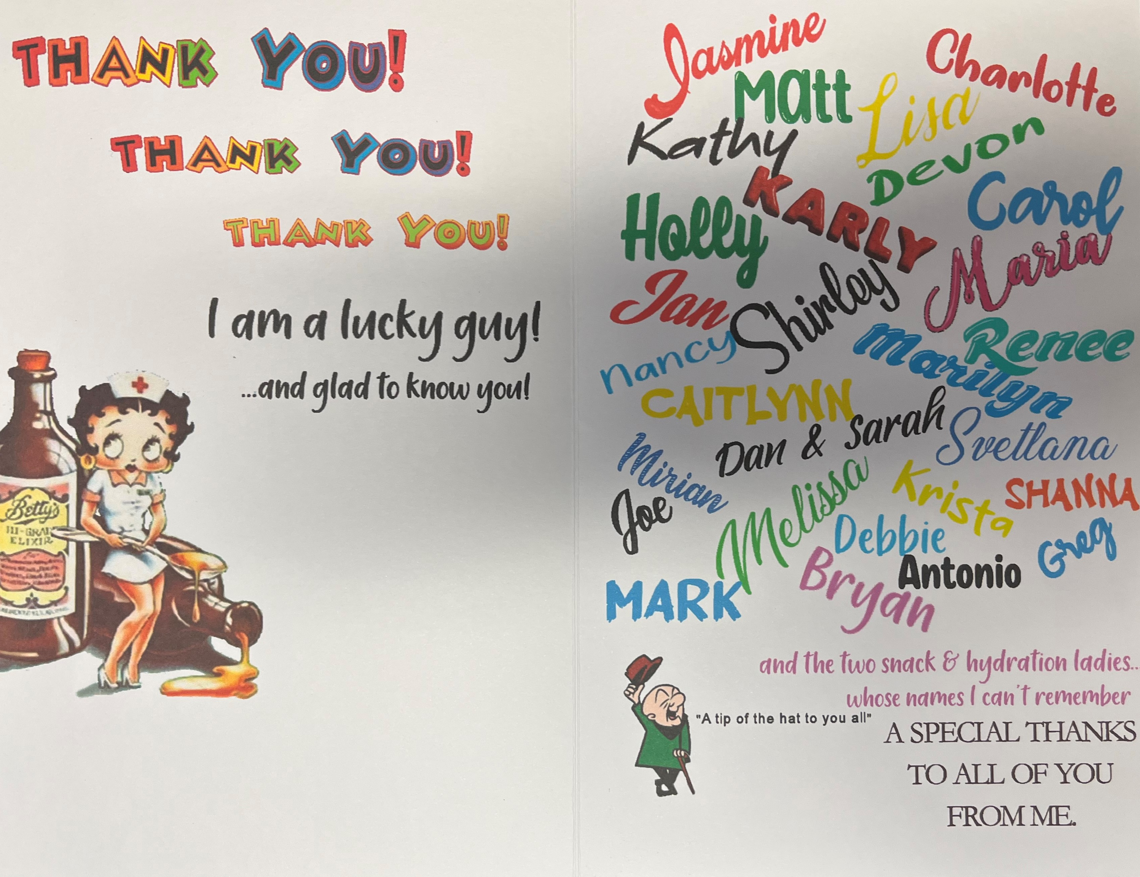
Special Thank You!
John Schreiner

Slide 19
CMO Report
Sandeep Vijan, Md,

Slide 20
CNO Report
Kelea Nardini, MSN, RN

Slide 21
CNO Update
Clinics
  USDA Mobile Clinic grant approved
Acute/ECU/ED
Lab
  Analyzers interfaced
RT
Radiology
  New digital room “under construction”
EMS
  New EMS Medical Director Dr. Elias
Pharmacy
  Permit Status update as of today (for context, we submitted plans 1/10/2022):
  State Plan Review: we are currently 6th in queue for review to begin.
  State FGI Plan Review: we are currently 32 in queue for review to begin.
  County: received permit 3/8/22
Surgical Services
  New Anesthesiologist hired-Dr. Keith Nichols
Infection/Employee Health

Slide 22
CFO/C0O Report
Colette Martin, MBA

Slide 23
CFO/COO Activities
IT
  Technology Investments for Expanse
    Interfaces for Hemodynamic Monitoring and Glucometers
  Computer Replacements for aging equipment
Finance Team
  Ongoing Audit and Cost Report Work
  Meditech Expanse GL Work
  Implementing Prelude – payment disbursement system (electronic payments to vendors)
Materials Management
  Implementing Handheld Technology (HHT) for inventory counting
  Converting to Electronic Ordering (EDI)

Slide 24
Meditech Expanse
✓September 15-16: Kick Off
✓ December 13 – 16: Integrated Testing
✓ January 11 – 13: Mock LIVE
✓ February 14 – 18: LIVE Copy
✓ March 1: GO LIVE

Slide 25
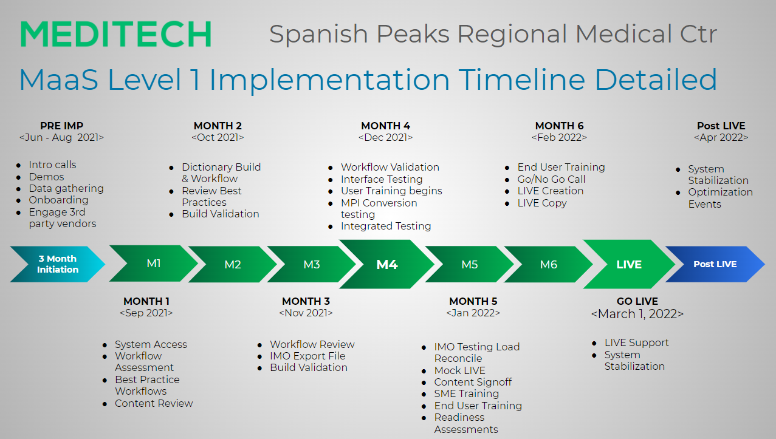

Slide 26
Financial Committee Report
March 24, 2022
Lola Spradley, Treasurer

Slide 27
Financial Statements Summary

Slide 28
Volumes Trending

Slide 29
Volumes Trending

Slide 30
Volumes Trending

Slide 31
Volumes Trending

Slide 32
PLC Update
Lola Spradley

Slide 33
Quality Update
John Davis, DPM

